Slide 1
IPND Infrastructure Options Pack
March 2021

Slide 2
Approval for Cloud Tenancy Architecture
The Integrated Public Number Database (IPND) is a centralised database that contains the record of each telephone number issued by CSPs to their customers in Australia. Under the Telecommunications (Carrier Licence Conditions - Telstra Corporation Limited) Declaration 2019, Telstra is appointed as the IPND Manager by the Federal Government and has an obligation to establish and maintain the IPND as an industry asset.
IPND Availability LCM is an initiative to migrate the ageing IPND solution spread across multiple DCs - 3rd party and Telstra, to a consolidated cloud tenancy. The program will drive simplicity, automation, resilience and efficiency for IPND leveraging modern technologies provided by the cloud. The following problems with current solution are being addressed by this project.
End of Support Life (EOSL) hardware
Delays in replacement parts
Reliability of tape-based backup solution
Backup Subsystem tape library slot/tape capacity
Disk capacity and potential storage failure
Database performance
Management network bandwidth
Software currency
The purpose of this pack is to detail the options explored for the target cloud tenancy based on IPND’s specific requirements and seek approval from the platform owner for the recommended option and approach.

Slide 3
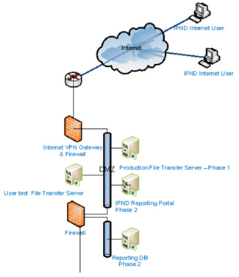
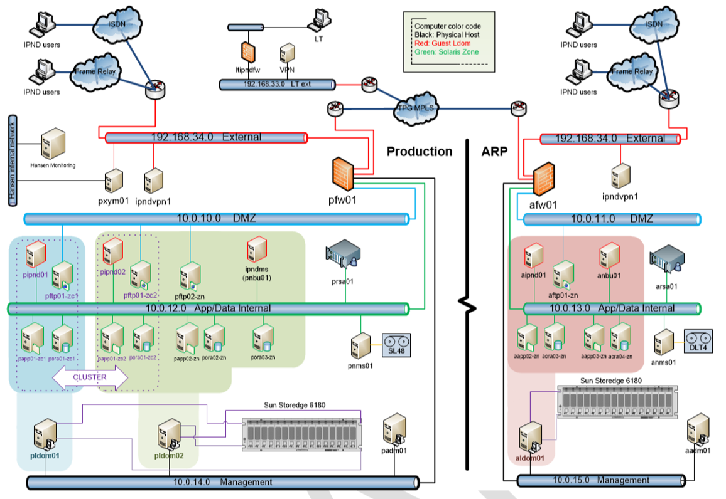
Overview – Current Architecture
Core System
IIS & Web Portal System
Hansen DC,
Sth. Melbourne
ARP
Production
IPSec VPN
Hansen DC, Doncaster
Telstra DC, Clayton
Hansen DC, Doncaster
IPSec VPN

Slide 4
IPND – Solution Characteristics
The following characteristics of IPND have to be considered and met while migrating to a new environment
IPND is an Industry Asset, not Telstra asset.
Telstra is the current appointed IPND Manager by the department as part of our Carrier License agreement.
Being an industry asset, it should be portable and transferrable to another carrier or 3rd party if deemed necessary by the department.
Self contained solution with no dependency on external systems.
Independent of Telstra’s IT systems.
Currently implemented and managed end-to-end by 3rd party – Logical Tech on behalf of Telstra
Independent access governance and user management
Independent monitoring and auditing tools
Data providers and users have access to IPND though a VPN connection over internet.
The migration should not introduce any changes to the user access and interface.

Slide 5
Overview – Target Architecture

Slide 6
Option 1: Telstra AMP Naked Tenancy
Migrate all components of the IPND solution to Telstra AMP Naked tenancy
Pros | Cons | Risks / Issues
Telstra certified for “Enhanced” workload Provide fully self managed tenancy No forced integration to Telstra IT systems keeping the solution portable Possibility to migrate to a serverless architecture in the future Leverage Telstra’s AWS enterprise discounts and support agreement | User access over internet via OpenVPN tunnel is not possible as all ingress from internet is required to go through AMP WAF which only supports HTTPS traffic. Security restrictions and lockdowns in place will restrict the level of access to the IPND operations staff | Issue: Impact to existing data providers and users access interface Risk: Logical Tech will not be able to maintain their support level with the restricted level of access

Slide 7
Option 2: Independent AWS Retail Account
Migrate all components of the IPND solution to an independent non-Telstra AWS account
Pros | Cons | Risks / Issues
No Customer Impact. Same URL and Public IP Provide fully self managed tenancy No forced integration to Telstra IT systems keeping the solution portable Possibility to migrate to a serverless architecture in the future | Cannot leverage in-place security certification Cannot leverage Telstra’s AWS enterprise discounts and support agreement Cannot track and manage utilisation under Telstra cloud expenses | Risk: Schedule and cost impact to implement and review the required Telstra security and compliance controls Issue: Impact to cost due to non-utilisation of Telstra volume discounts

Slide 8
Option 3: Telstra Cloud Enablement “External” Tenancy
Migrate all components of the IPND solution to Telstra CE “External” tenancy
Pros | Cons | Risks / Issues
Telstra certified for “Enhanced” workload Possibility to migrate to a serverless architecture in the future Leverage Telstra volume discounts and enterprise support | Direct user access over internet via OpenVPN tunnel is not possible and will require CSP integration impacting portability Not self managed Unsuitable Service Control Policies and forced integrations in place impacting the portability requirement Security restrictions and lockdowns in place will restrict the level of access to the IPND operations staff | Issue: Impact to existing data providers and users access interface Risk: Logical Tech will not be able to maintain their support level with the restricted level of access Risk: Reliance on Telstra’s methods and governance of operational access to the environment may reduce the current service levels

Slide 9
Option 4: Telstra Cloud Enablement “Isolated” Tenancy (Recommended)
Migrate all components of the IPND solution to Telstra CE “Isolated” tenancy
Pros | Cons | Risks / Issues
No Customer Impact. Same URL and Public IP Provide fully self managed tenancy No forced integration to Telstra IT systems keeping the solution portable Possibility to migrate to a serverless architecture in the future Leverage Telstra volume discounts and enterprise support | Cannot leverage in-place security certification. | Risk: Non-compliance to Telstra security and privacy standards Risk: Schedule and cost impact to implement and extensive review of the required security and compliance controls

Slide 10
Key Risk/Issues for Recommended Option - CE “Isolated” Tenancy
Risks/Issues | Mitigation
Risk: Non-compliance to Telstra security and privacy standards | Ground up design and implementation of the security, monitoring and auditing solution and extensive review in collaboration with Security Architecture team to ascertain compliance to Telstra security and privacy standards for “Enhanced” workloads.
Risk: Schedule and cost impact to implement and maintain required security and monitoring controls | No mitigation available. Risk to be accepted by business and operations stakeholders.

Slide 11
Summary
Tenancy | No User Impact | Solution Portability | No Operations Impact | Enterprise Support | Enterprise Discount
Cloud Enablement “Isolated” (Option 4) | ✓ | ✓ | ✓ | ✓ | ✓
AWS Retail Account (Option 2) | ✓ | ✓ | ✓ | ✗ | ✗
Cloud Enablement “External” (Option 3) | ✗ | ✗ | ✗ | ✓ | ✓
Telstra AMP Naked (Option 1) | ✗ | ✗ | ✗ | ✓ | ✓

Slide 12
IaaS/PaaS Shared Responsibility Model
Customer Data, Application Identity and Access
Platform Management
Application & Code Management
Internet Access, Monitoring and Logging.
(tools provided by platform)
Logical Tech
Data Encryption & Data Integrity.
Authentication
Code And Data Encryption.
Provided by Platform
(Protection of Data at Rest)
Network Traffic Protection & Firewall Configuration.
(Protection of Data in transit)
Responsible for security and support “in” the Cloud
Operating System and Network Configuration
AWS
Compute
Storage
Database
Networking
Regions
Edge Locations
Responsible for security and support “of” the Cloud
AWS Global Infrastructure
Availability Zones

Slide 13
Appendix

